Slide 1

RT Academy – RT’s international educational project
academy.rt.com

Slide 2
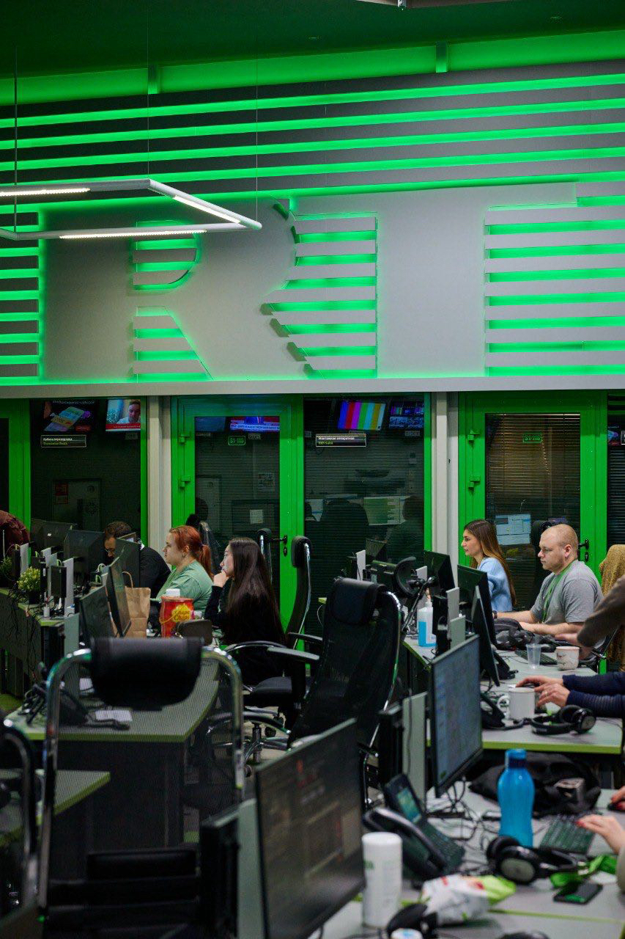
FREE online course on International TV and Online Journalism
Recorded master-classes from RT’s TOP correspondents, presenters, producers, creators + LIVE webinars
October 14 - November 8
20+ lessons, 4 weeks, practical tips and feedback
Upon completion: certificate and chance to join RT's global family

Slide 3
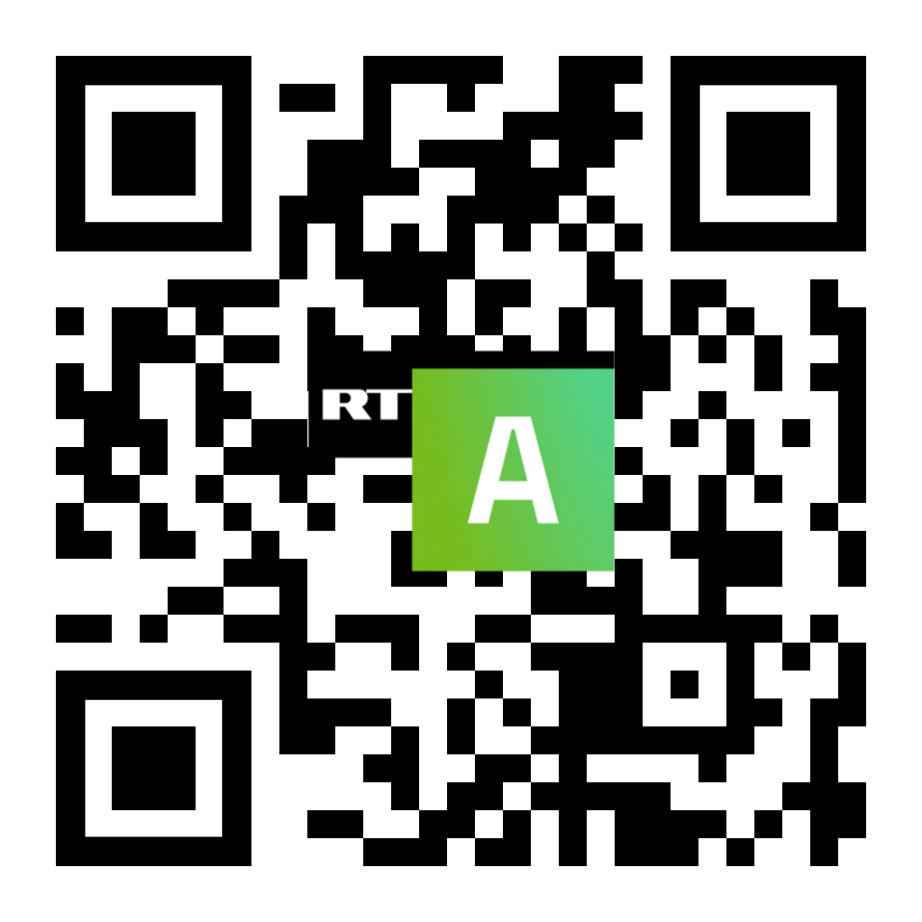
Join for FREE
academy.rt.com

