Slide 1
Home for Innovation and Entrepreneurship in Namibia

Slide 2
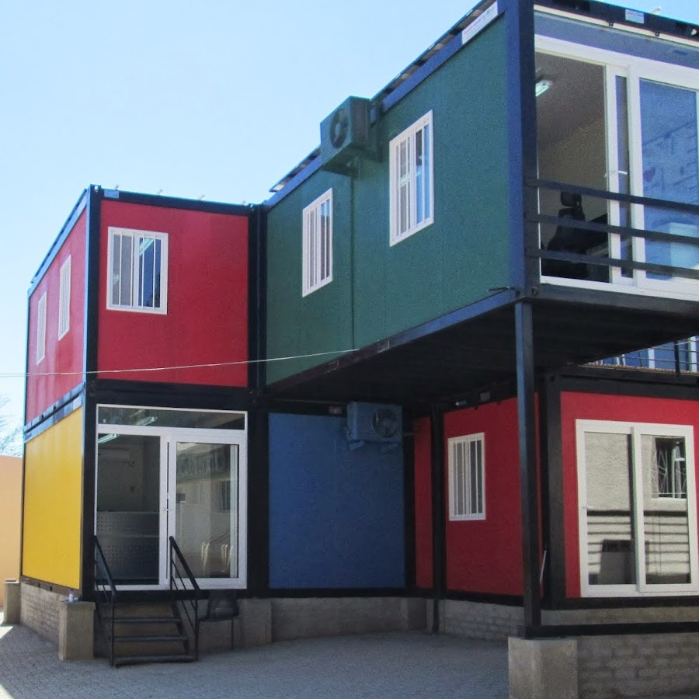
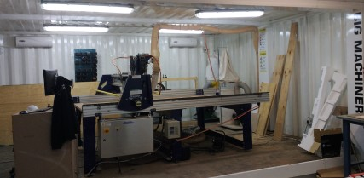
The Lab

Slide 3
Manufacturing & Machining
3D printing
3D Scanning
Laser cutting & engraving
Circuit design and fabrication
Embroidery
CNC machining
Vacuum forming
Vinyl printing and cutting
Advanced prototyping and fabrication services

Slide 4
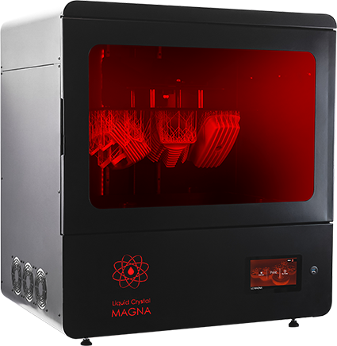
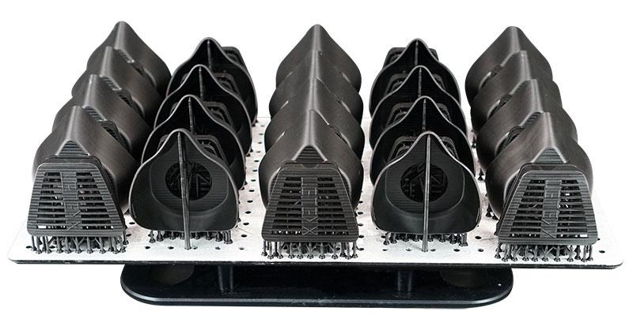
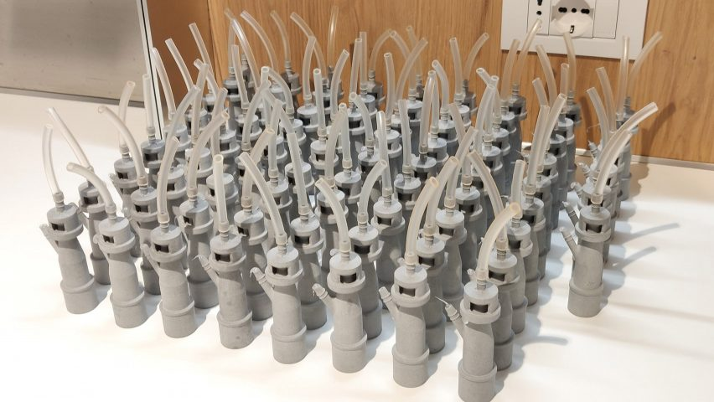
Resin 3D printing

Slide 5
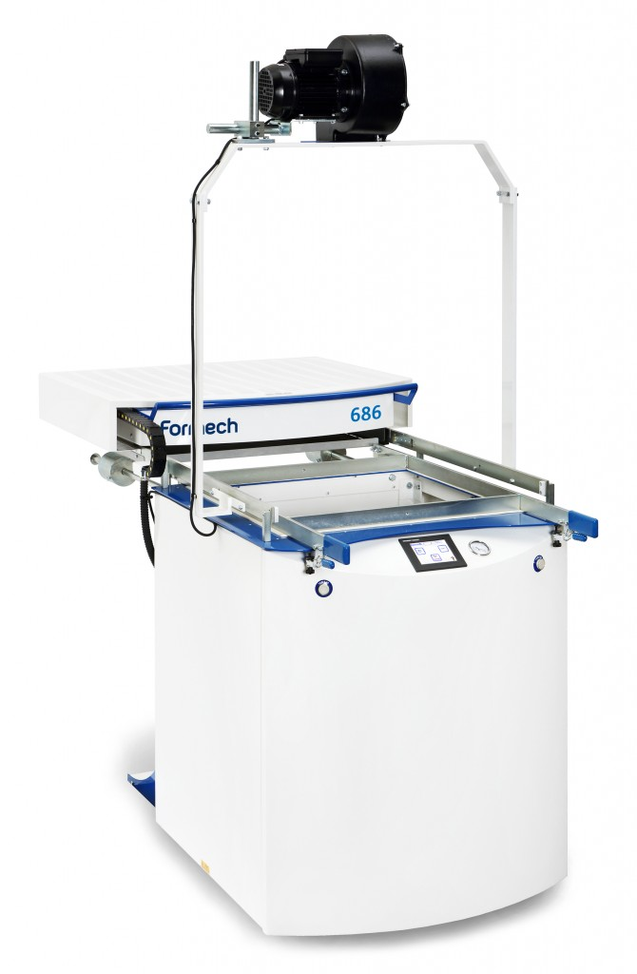
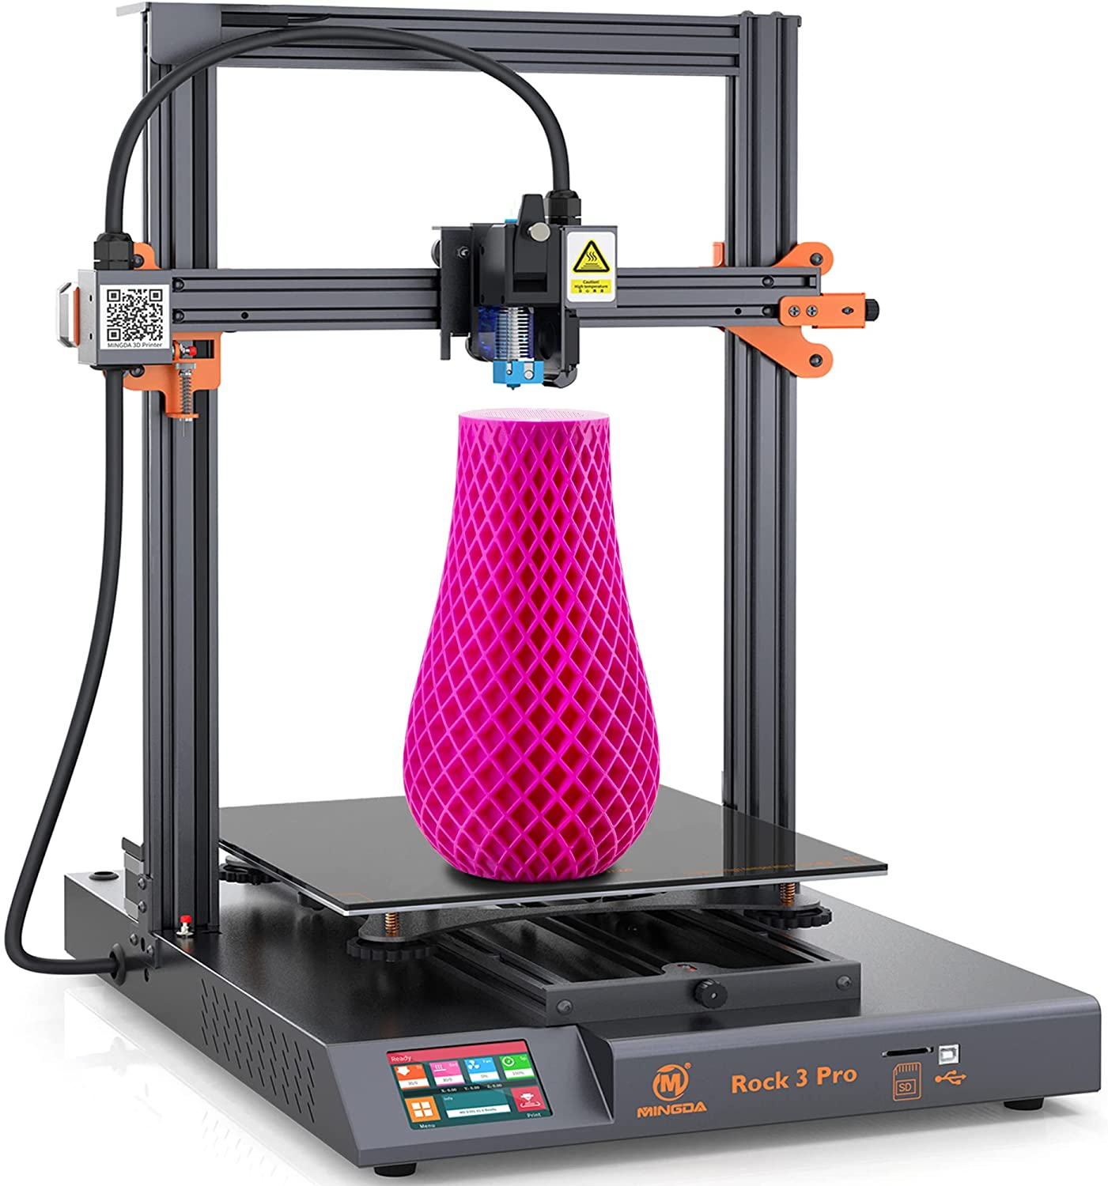
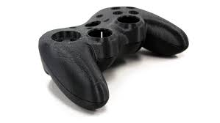
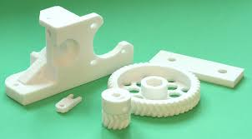
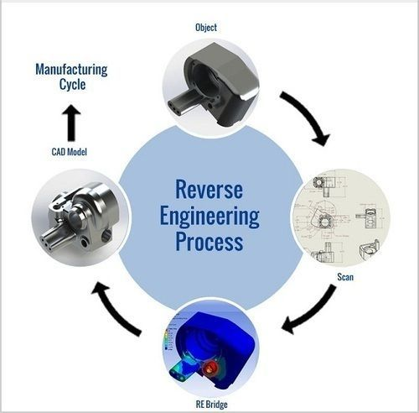
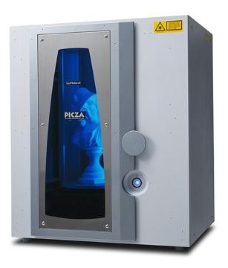
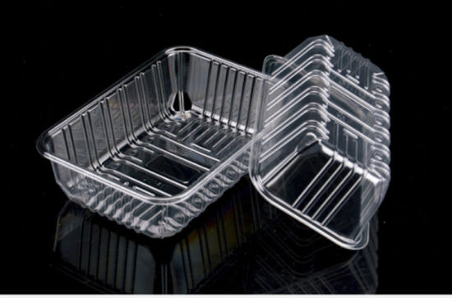
FDM 3D printing
3D Scanning
Vacuum forming

Slide 6
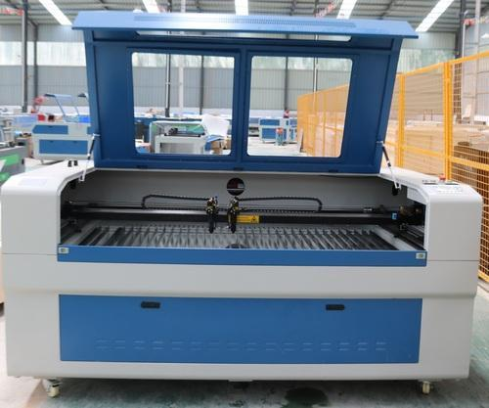
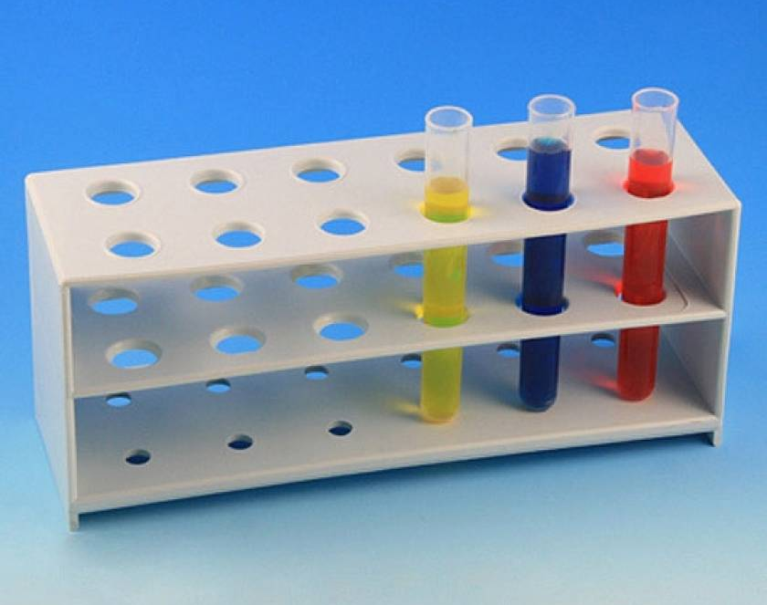
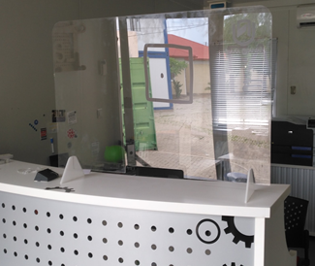
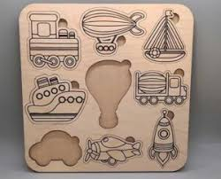
Laser Cutter

Slide 7
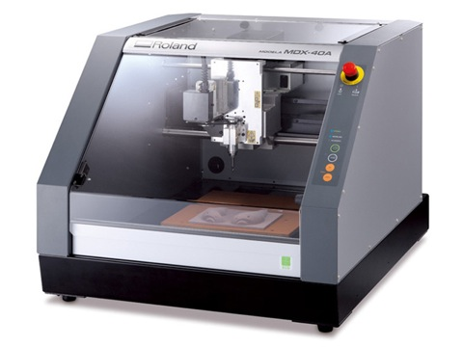
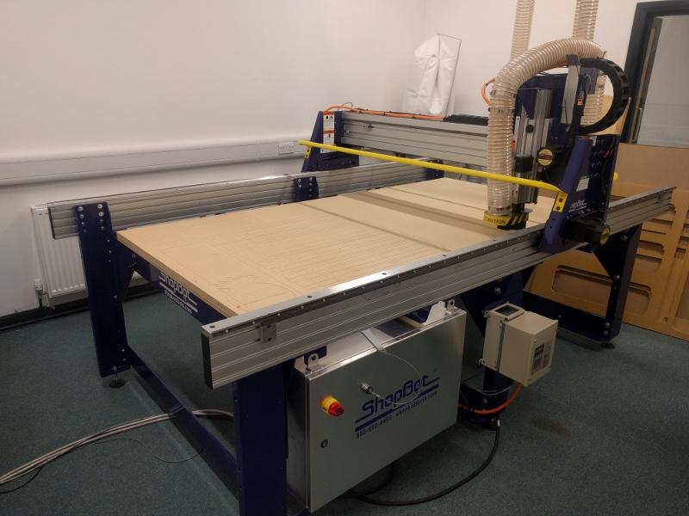
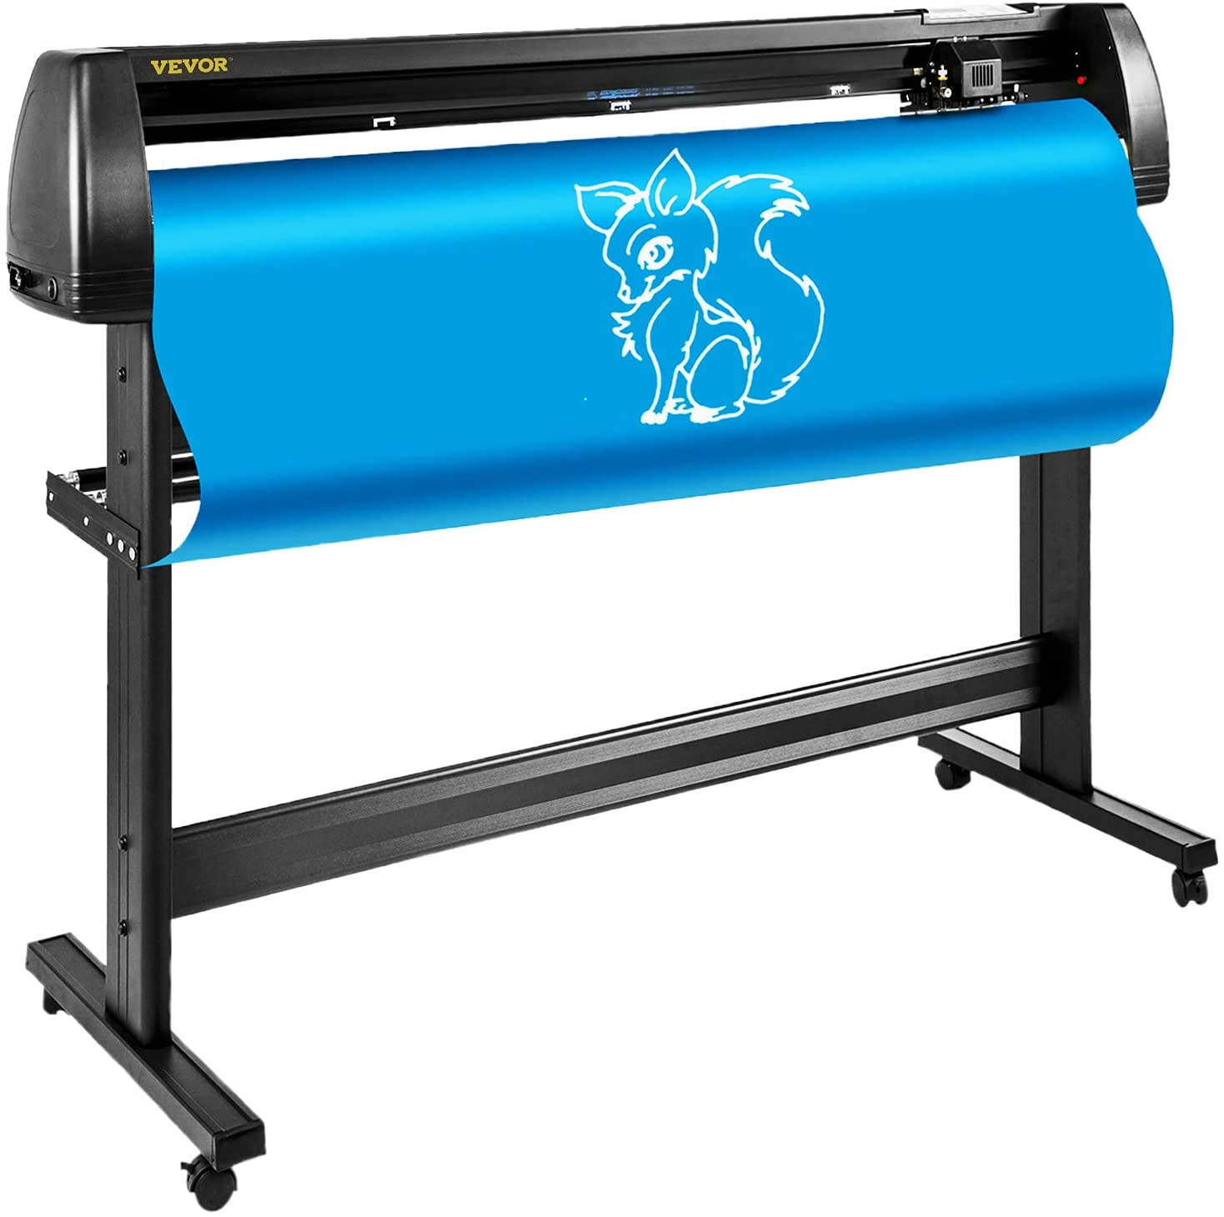
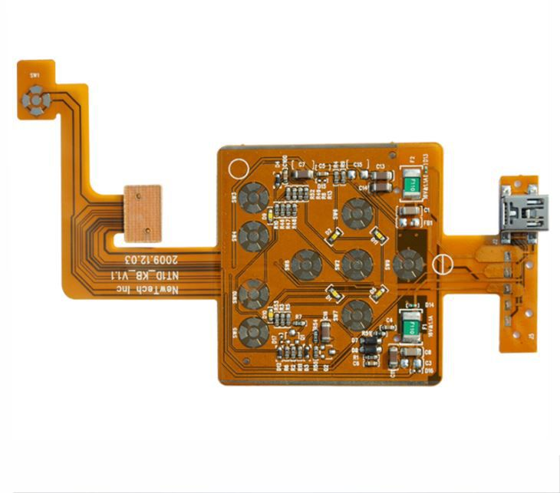
Vinyl Printer
Large Format router
MDX40-A router

Slide 8
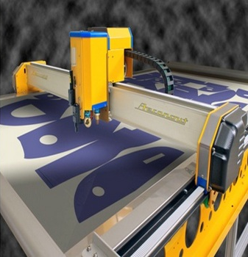
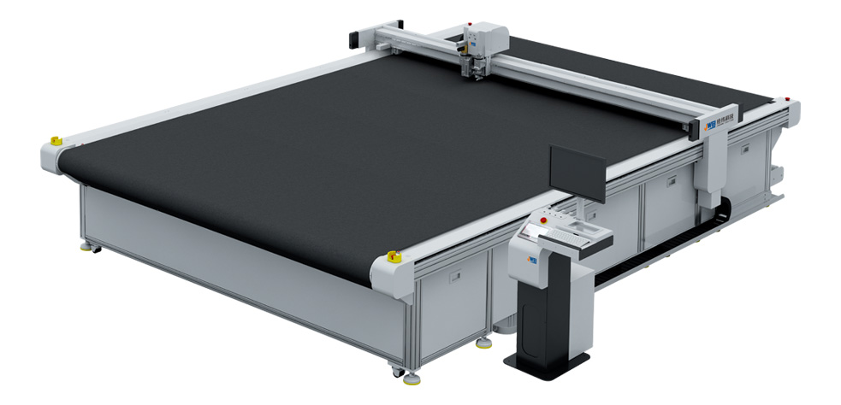
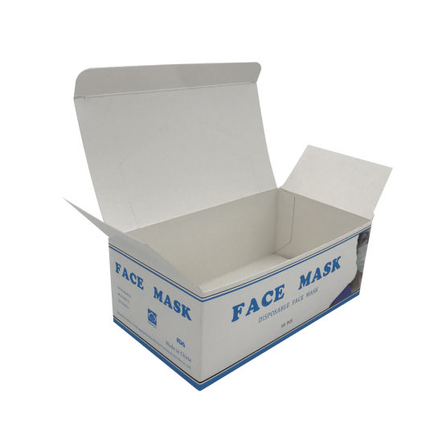
Digital Cutter

Slide 9
Innovation
Incubation Centre

Slide 10
Entrepreneurs
Early adopter of breakthrough technology startups
Prototyping
Product development
Hosting disruptive business models

Slide 11
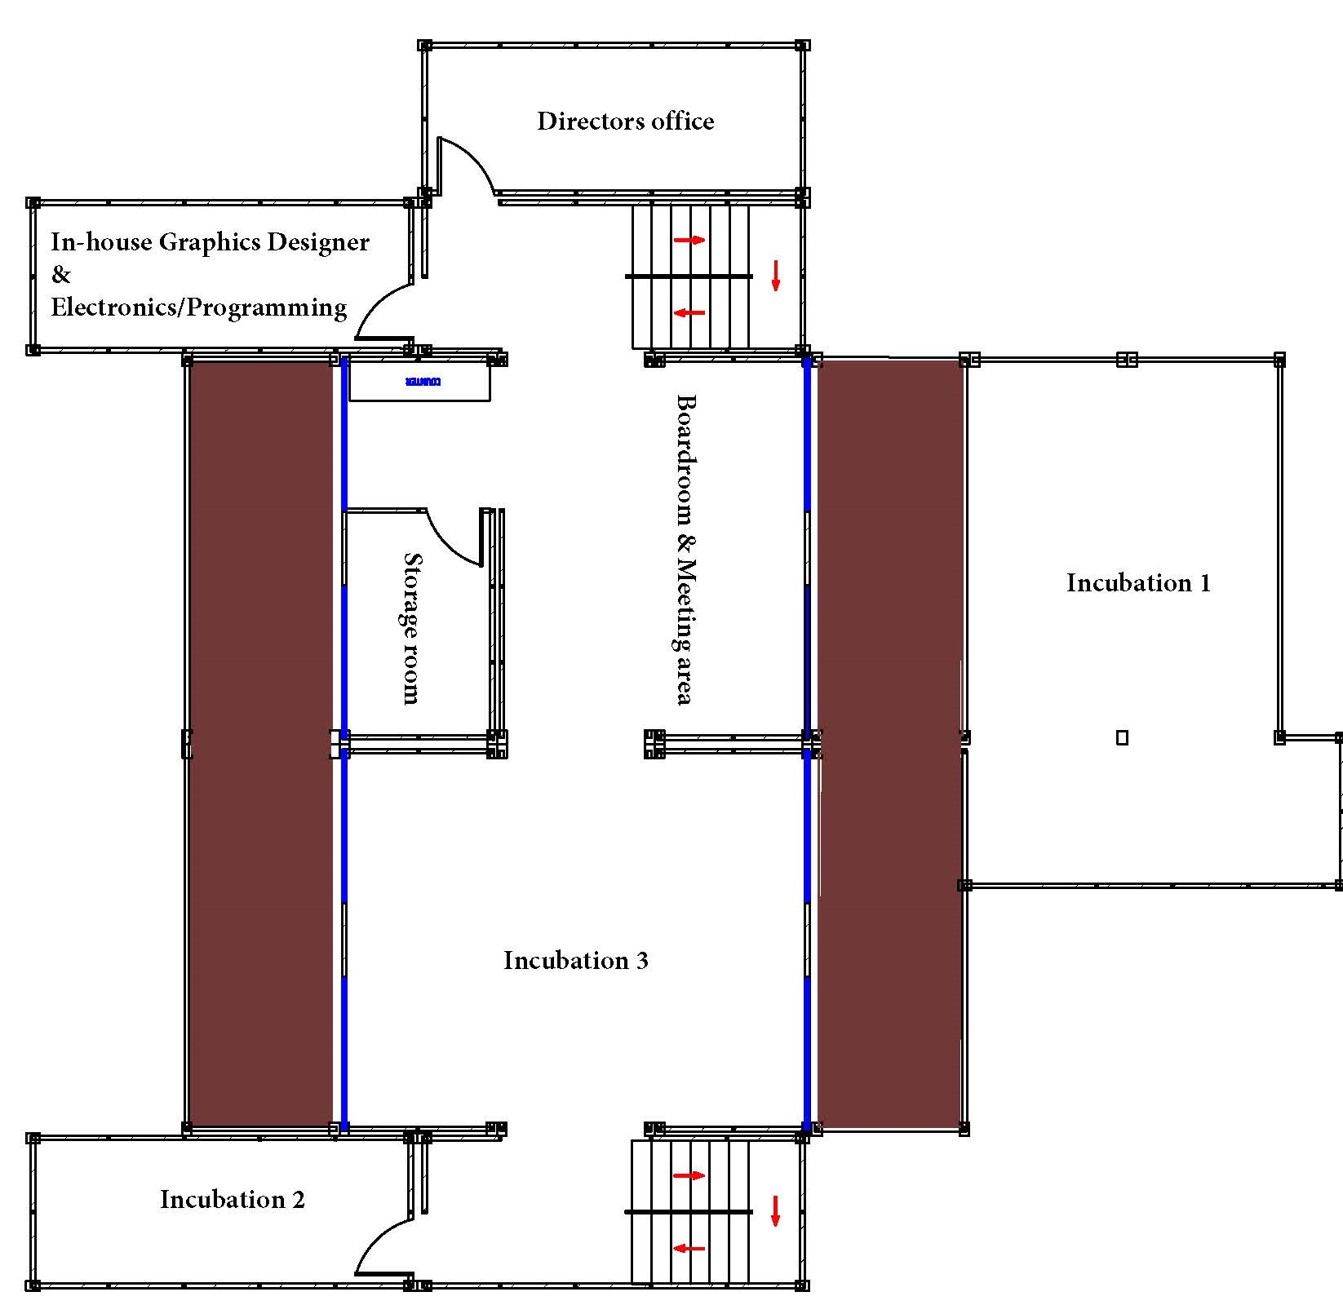
Incubation Space
Creating an environment that stimulates innovation and team-work
7 Containers, 1029m² total area
Ability to incubate at least 4 independent* Companies/Organisations

Slide 12
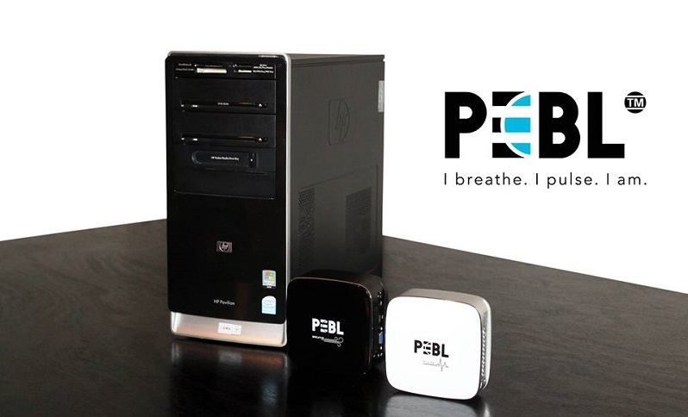
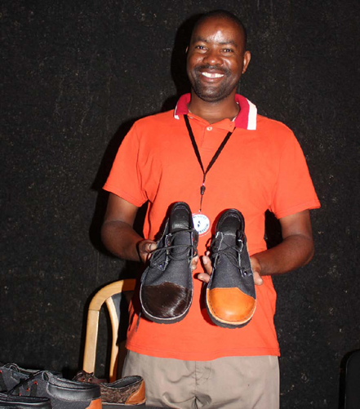
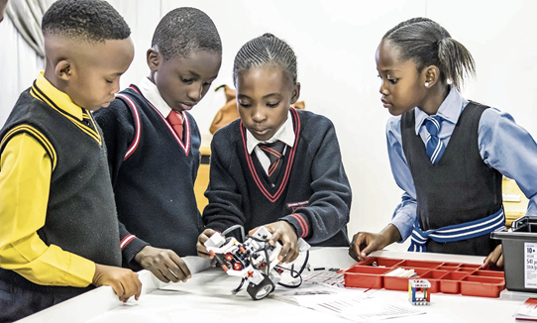
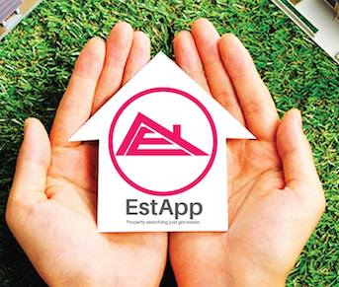
Startups Incubated to date

Slide 13
COVID-19
Sneeze guards
Face-shields
Ventilator parts
Assistive devices
Manufacturing for the new normal

Slide 14
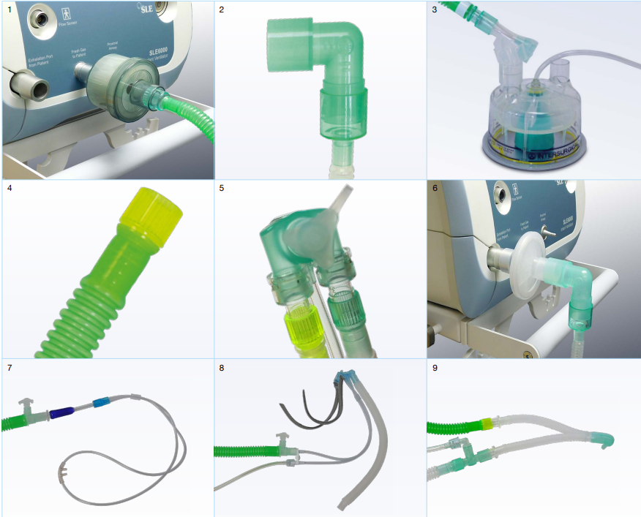
Ventilator Peripherals
Overcoming shortages in health sector delivery
Solution for broken supply chain
Ventilator parts
Assistive devices

Slide 15
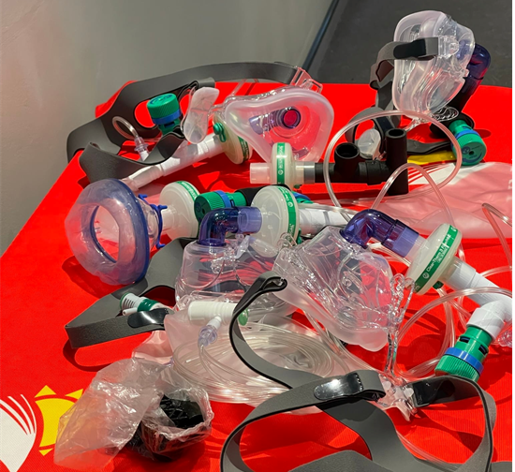
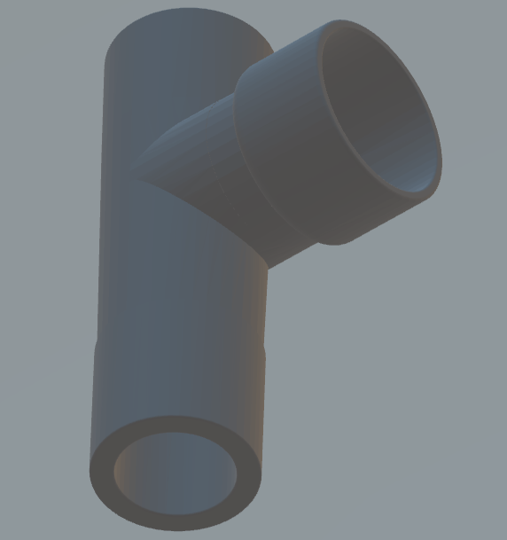
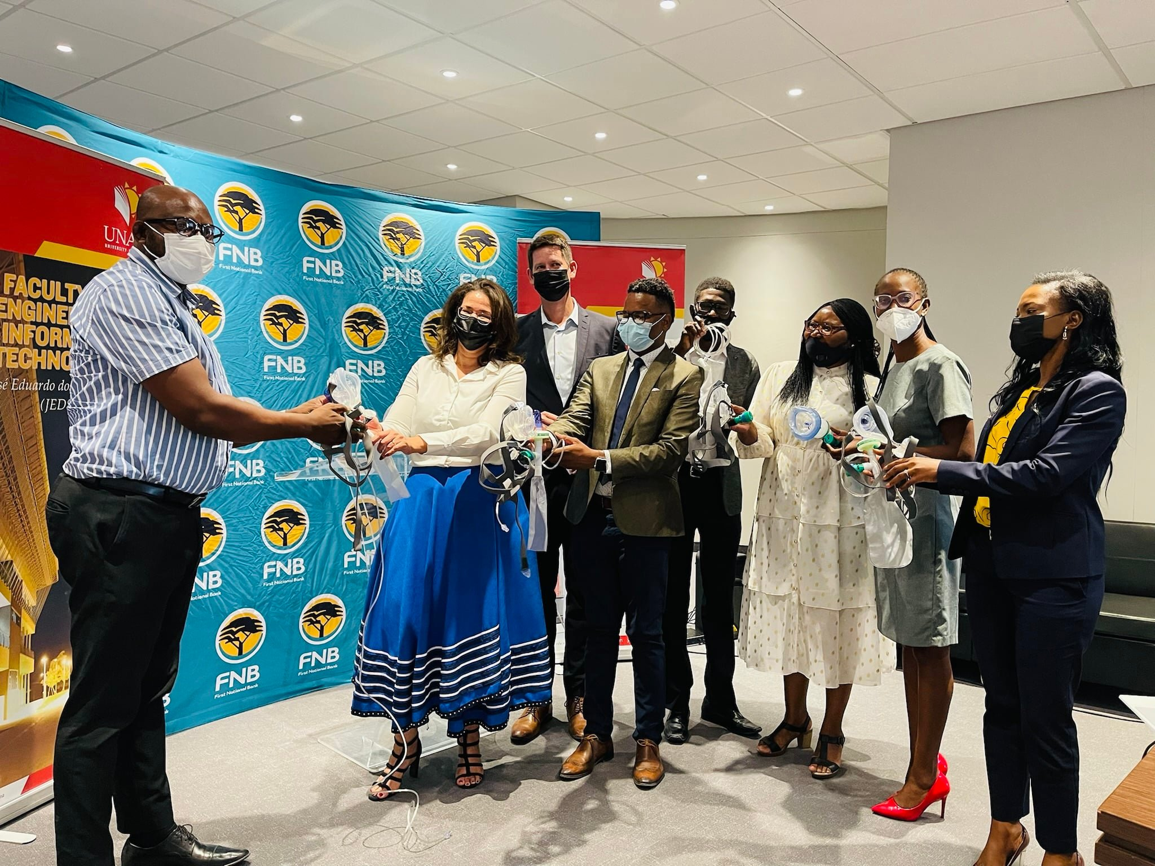

Slide 16
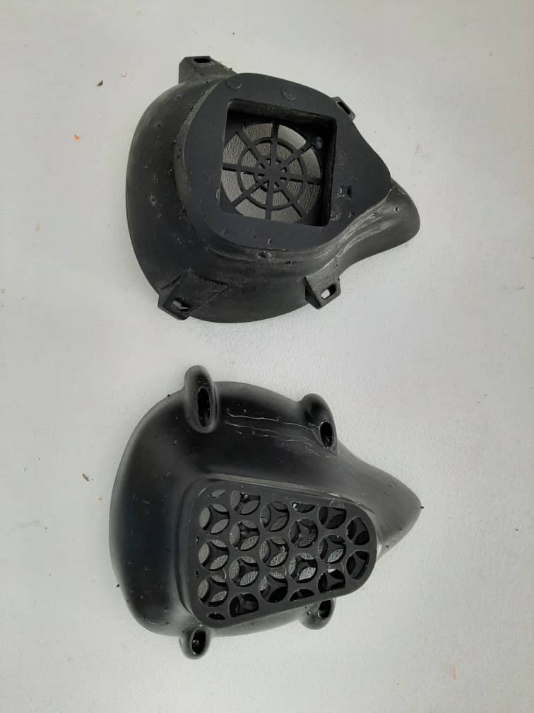
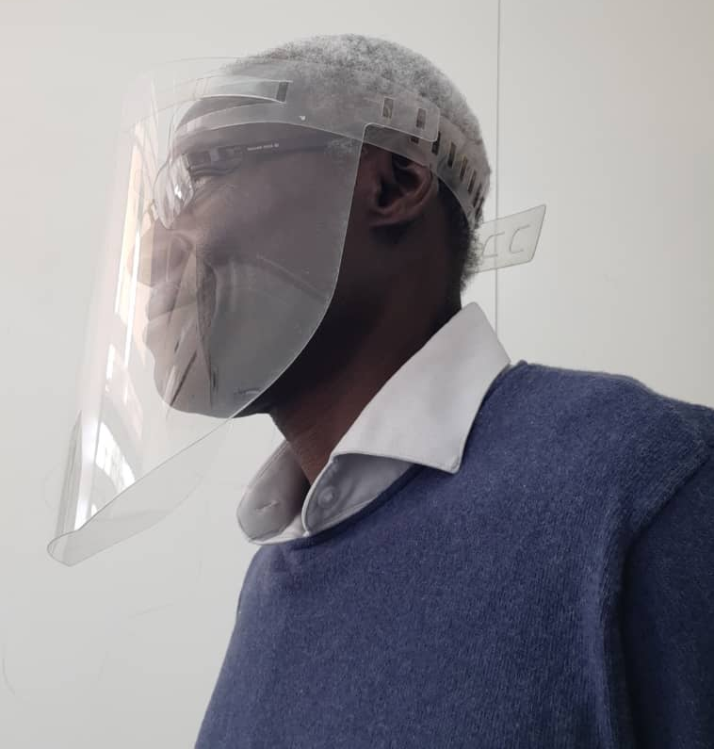
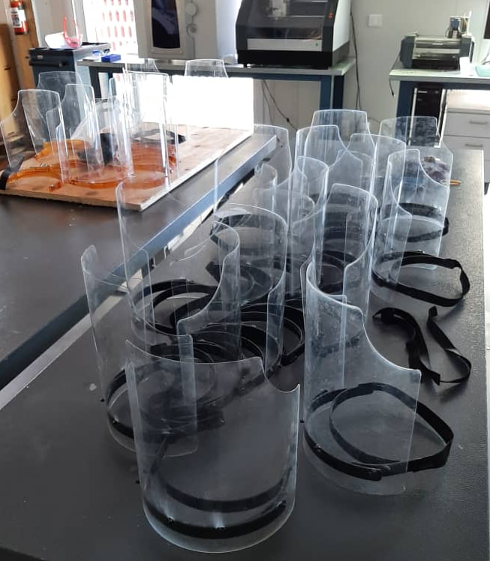

Slide 17
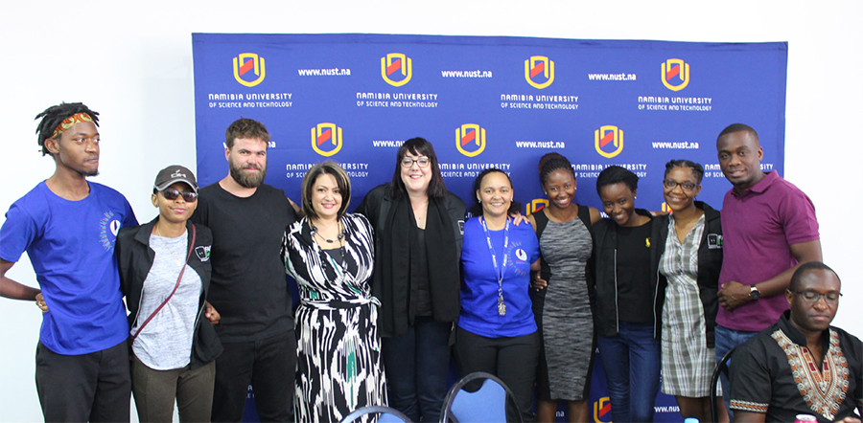
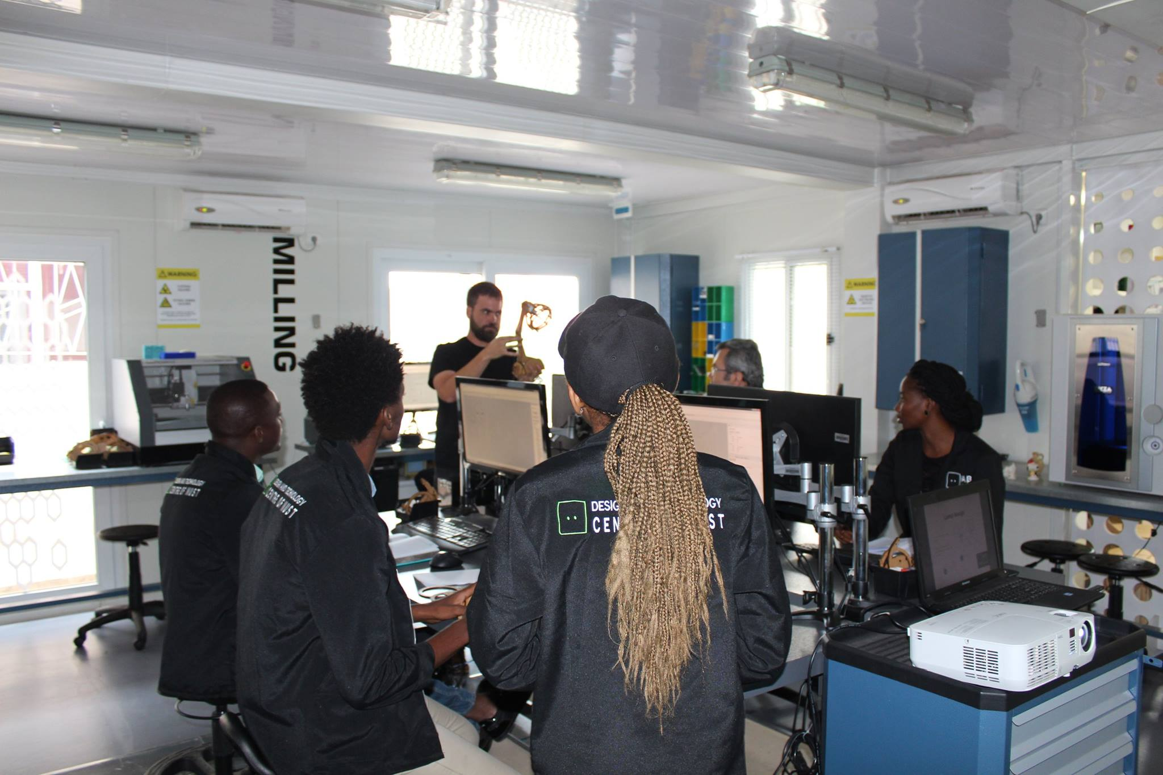
Internships & Workshops Training & seminars

Slide 18
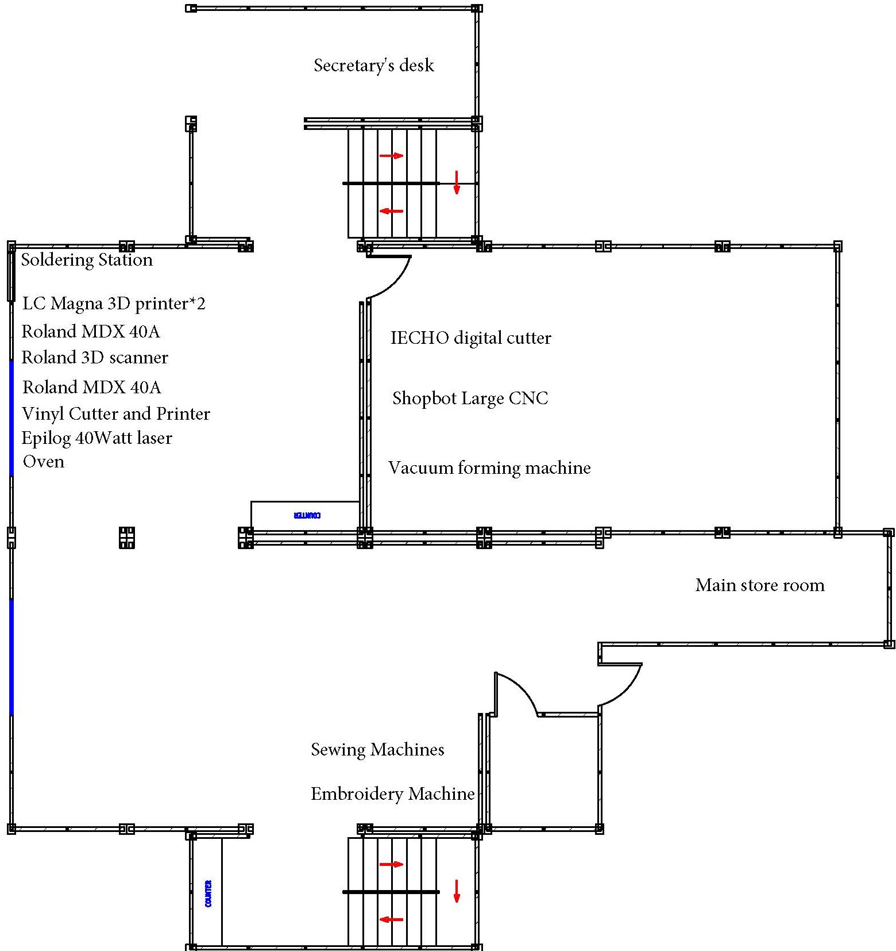
Modularity
Tools for Industry 4.0

Slide 19
Questions?
sjohn@nust.na; mnauta@nust.na
www.nust.na

